Slide 1
Ultra-Low-Power Edge Hemodynamic Monitoring
A Denoising Autoencoder and 1D-CNN Pipeline for Real-Time BCI
Presenter: Kaveh Ramezani
Deep Learning (Spring 2026)
Instructor: Dr. Liang Dong

Slide 2
Outline
Introduction & Motivation
Database
Classifier
Denoising (Autoencoder)
To Hardware

Slide 3
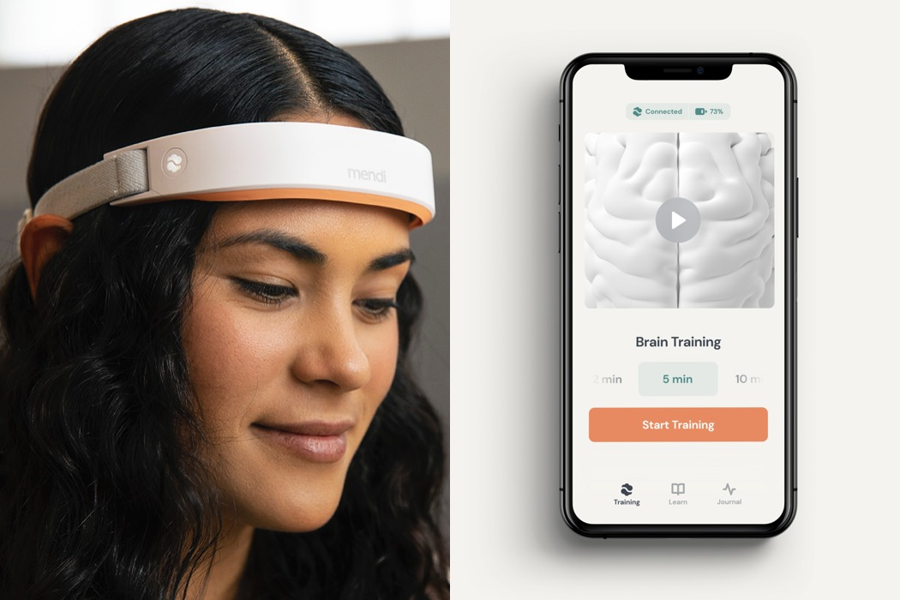
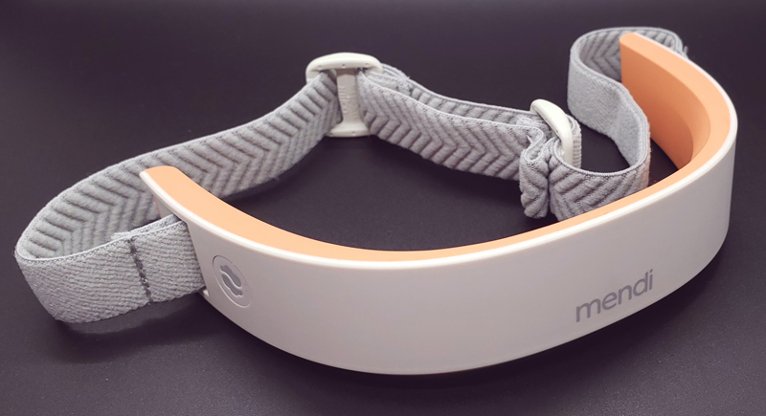
Introduction and Motivation
Cerebral monitoring is shifting from clinical labs to daily environments.
Mobile BCI:
Mental Health Tracking: Continuous stress and anxiety monitoring.
Neurofeedback: Enhancing focus through real-time hemodynamic visualization.
BCI Control: Direct neural-to-digital interface for assistive technologies.
[1]

Slide 4
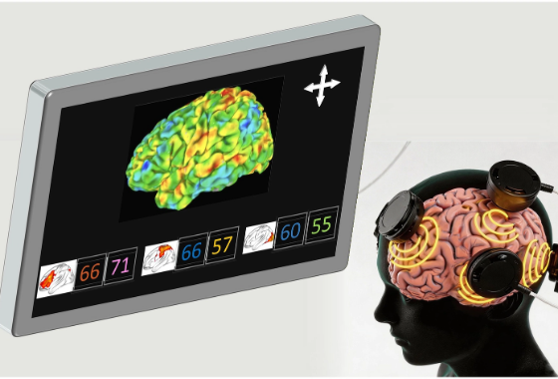
Introduction and Motivation
HEG uses Near-Infrared light to measure the ratio of oxygenated to deoxygenated hemoglobin in specific brain regions.
Feature | HEG / fNIRS | fMRI
Portability | Wearable | Stationary
Cost | Low-cost | High (Millions)
Generated By Google Gemini

Slide 5
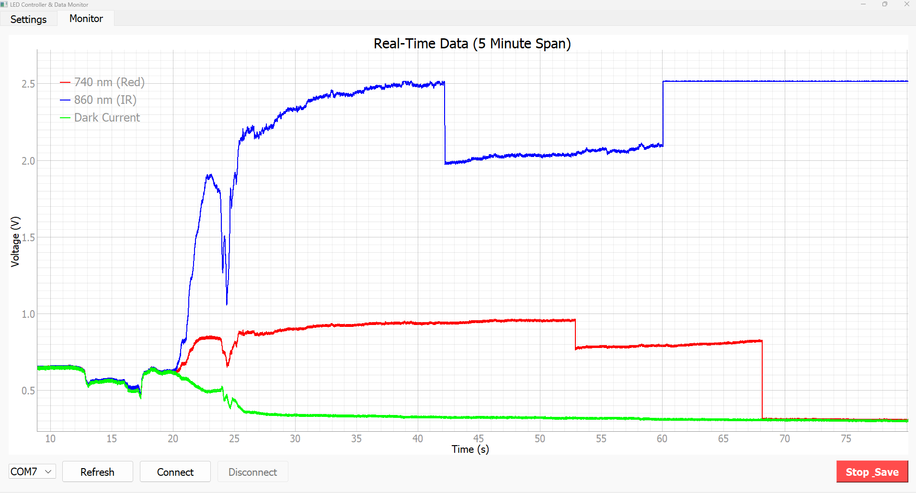
Introduction and Motivation
Environment & Motion Artifacts
Raw HEG signals from Analog Front-End (AFE) are fragile. Accuracy is compromised by:
Motion Artifacts (MA): Physical movement shifting sensor-skin coupling
Light Leaking: Ambient light saturating the photodetector
High Amplitude Noise: Spikes exceeding signal magnitude by 100x
740 nm
860 nm
Dark Current
Motion
Light Amplitude Change

Slide 6
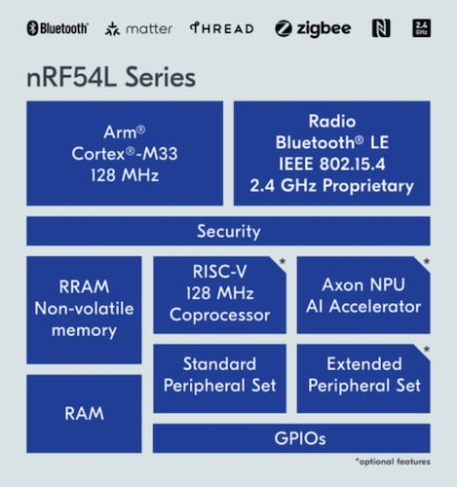
Introduction and Motivation
Spectral Overlap: Motion artifacts often occur in 0.1 – 0.5 Hz (Same as the signal).
Non-Linearity: Non-linear, transient spikes.
Real-Time Need: Sub-second latency is required for neurofeedback.
Deep Denoising: Training Micro-CNNs to reconstruct clean signals.
State Classification: Differentiating cognitive states: Rest vs. Motor Task vs. Motion.
Edge deployment: Optimizing for Nordic Axon NPU using INT8 quantization for.

Slide 7
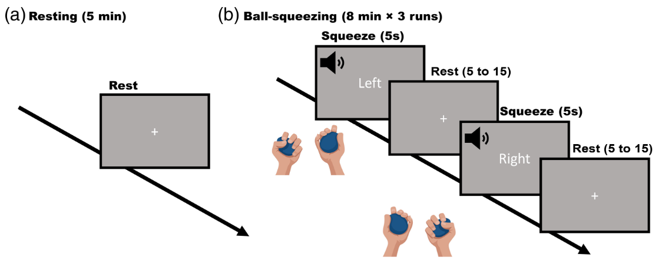
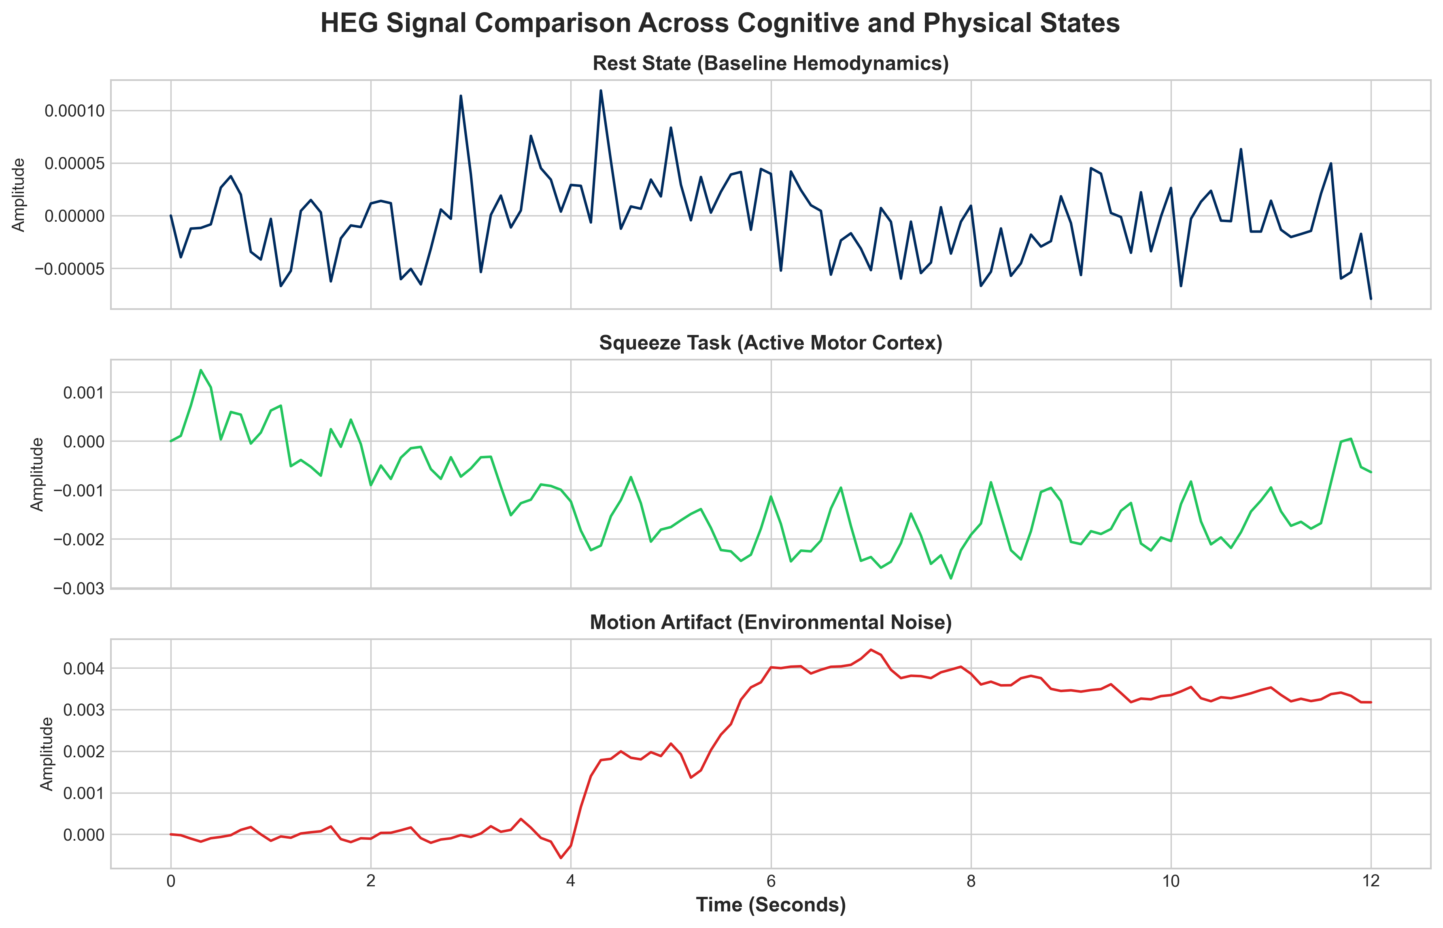
Database
OpenNeuro ds007420
Motor Task: Purposeful ball-squeezing
Artifacts: Annotated head and body movements.
Scale: 12 participants across 3 experimental sessions
Ground truth for “Active” vs “Artifact” states.

Slide 8
Classifier
121 samples (12 seconds)
200 inputs
Hardware NPUs are optimized for 2D images.
To maximize throughput on the Axon NPU,1D signals were reshaped.

Slide 9
Classifier
Float32 (Original)
INT8 (Quantized)

Slide 10
Denoising (Autoencoder)
The DAE processes 200-channel optode data through a bottleneck compression to force feature extraction.
Encoder: Dual Conv1D (64 filters) + MaxPool1D layers reduce 121 time-steps to 30.
Bottleneck: Compressed representation rejects high-frequency stochastic noise.
Decoder: Conv1DTranspose restores the temporal dimension to 121 samples.
Output: A purified hemodynamic wave ready for the 1D-CNN classifier.

Slide 11
Shape-Aware Loss
$$Loss_{Total}=MSE+\left(0.5×SlopeLoss_{Diff}\right)$$
Beyond MSE: Traditional Mean Squared Error fails to capture temporal dynamics in noisy hemodynamic signals.
Derivative Penalty: Our custom loss function penalizes differences in slopes between adjacent time steps.
Fidelity Preservation: Prioritizes the low-frequency hemodynamic curve over high-frequency stochastic noise spikes.
Outcome: Stable reconstruction fidelity even under 50% noise injection.

Slide 12
Summary of Quantization

